Slide 1
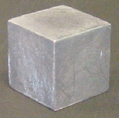
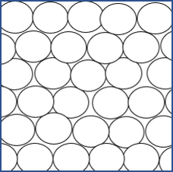
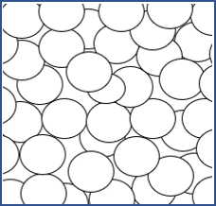
Particle model SL
1 Solids are made from very small particles.
Imagine you could see the particles in this block of lead.
Which diagram best matches what you would see?
A Particles not moving
B Particles shaking on the spot
C Particle moving freely
D Particles not moving

Slide 2
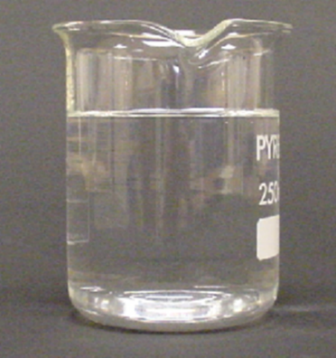
Particle model SL
2 Imagine you could see the particles in this beaker of water.
Which diagram best matches what you would see?
A Particles not moving
B Particles not moving
C Particle moving freely
D Particle moving freely

Slide 3
Particle model SL
3 Here is a block of copper at room temperature.
Which statement best describes it?
A
It is made of particles which are hard – like tiny bits of solid
B
There are particles in rows surrounded by solid copper
C
It is made of particles which are not like bits of solid copper
D
It does not have any particles

Slide 4
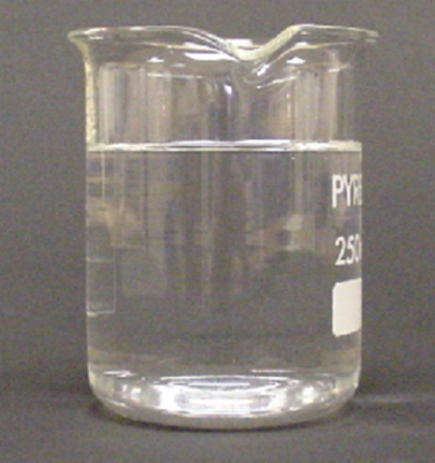
Particle model SL
4 Here is some water at room temperature.
Which statement best describes it?
A
It is made of particles which are not like bits of liquid
B
It does not have any particles
C
There are particles dotted about surrounded by liquid water
D
It is made of particles which are runny, like drops of liquid

